Slide 1



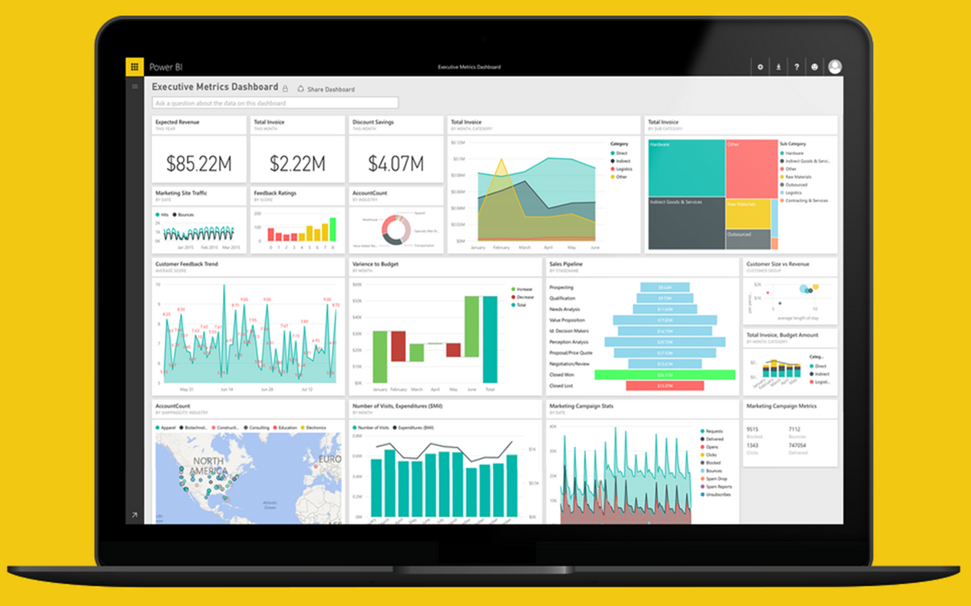
Project Professional Workshop Program
Chicagoland Power BI User Group
Notes:
We are so excited to introduce the Project professional Program for the Tampa User Group!
Based on the feedback from the previous meetings we had, we realized we want to EMPOWER you to become a skilled PBI professional in your organization and taking the skills and apply them to your career.
This will be part of the upcoming years content & meetings that will culminate with a Contest at the end of the program

